Slide 1
Web Application Testing Final Project
Mustash.ro

Slide 2
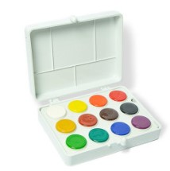
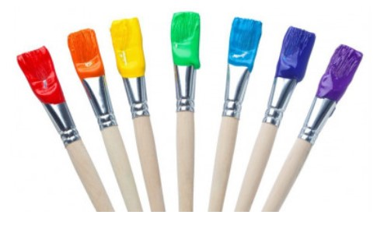
Application Description
Mustash.ro
Web application;
E-commerce merchant, painting and crafting products retailer;
National shipping

Slide 3
Testing Approach Tools used
Ad-hoc Testing to decide if the application is worth further testing
Exploratory Testing for main functionalities
Document the Exploratory Testing and write down the defects so they can be replicated
Component Testing, Integration, System, System Integration Testing
Focus where bugs were identified, more testing for that area
Write the Smoke tests and execute them
Write the Test Report
Mantis Bug Tracker
– Bug Reporting
Microsoft Office
–Test Case Management
– Test Report
Lightshot
– Screenshots Capture
Xmind Tool
– Smoke Test Cases Map
Fake Filler
– Input Testing Data

Slide 4
Testing types
Applicable
Performance Testing
Security Testing
In case of fixing the logged bugs:
Re – Testing
Regression Testing
Performed
Functional Testing
- Exploratory Testing
- Smoke Testing
- Positive Testing
- Negative Testing
- UI Testing
- Usability Testing
- End to End
Non - Functional Testing
- Recovery Testing
- Compatibility Testing

Slide 5
Smoke Test Cases Overview
Total: 156 Test Cases
Smoke test cases
Main tabs
Account
Search functionality
Add to cart
Cart functionality
Checkout
On click functionality
5 Test Cases
Create new account
25 Test Cases
Using Search input field
15 Test Cases
Identical items
20 Test Cases
Update an item
4 Test Cases
Checkout as guest
14 Test Cases
Login
13 Test Cases
By Browsing
8 Test Cases
Different items
3 Test Cases
Remove an item
2 Test Cases
Create account and checkout
3 Test Cases
My account
38 Test Cases
Main buttons
2 Test Cases
Login and checkout
1Test Case
Logout
2 Test Cases
Checkout with existing account
1 Test Case

Slide 6
Bugs overview
Minor
2 Bugs
Major
3 Bugs
Normal
4 Bugs
Search functionality
Add to cart
Critical
1 Bug
Account
Number of Bugs and Severity
Cart Functionality
Normal
9 Bugs
Major
1 Bug
Minor
2 Bugs
Main tabs
Checkout
Major
1 Bug
Minor
1 Bug
Total number of bugs: 24
1 Critical 5 Major 13 Normal 5 Minor

Slide 7
Conclusions Chalenges
156 Test Cases were executed to test the major functionalities:134 passed and 22 failed
22 bugs were identified:1 Critical, 5 Major, 13 Normal and 5 Minor
Most of the bugs were identified by performing Exploratory Testing and Negative Testing
Data type used during testing: Blank, Valid, Invalid, Big Data
Lack of requirements
Using too much invalid data in production
Using the relevant data in order to cover the most important testing scenarios
Gathering all the information into the Test Report Document
Gathering all the test data into the Test Data Report

